Slide 1

Microsoft Azure Well-Architected Framework
[Month] [Start Date – End Date]
#MSOpenHack

Slide 2
Agenda
<date> | <date> | <date>
9:00 – 10:00 AM | Opening + Welcome 10:00 AM – 12:00 PM | Team Hacking 12:00 – 1:00 PM | Break 1:00 – 4:00 PM | Team Hacking 4:00 PM | End of Day 1 | 9:00 – 9:30 AM | Morning Announcements 9:30 AM – 12:00 PM | Team Hacking 12:00 – 1:00 PM | Break 1:00 – 4:00 PM | Team Hacking 4:00 PM | End of Day 2 | 9:00 – 9:30 AM | Morning Announcements 9:30 AM – 12:00 PM | Team Hacking 12:00 – 1:00 PM | Break 1:00 – 3:30 PM | Team Hacking 3:30 – 4:00 PM | Closing Remarks 4:00 PM | End of OpenHack

Slide 3
Tech Lead and Project Lead
[name] Tech Lead
[name] Project Lead

Slide 4
What is OpenHack?
+
Open
Hack
A wide variety of participants
Hands-on experimentation using challenge-based content
Notes:
Microsoft OpenHack is a developer-focused engagement that connects development teams (Open) with experts to tackle a series of real-world challenges through hands-on experimentation (Hack) in-person or online (Virtual).

Slide 5




OpenHack Principles
Challenge-based
Increasing difficulty (challenges build on one another) – content sourced from OpenHack repository
Team-based
Everyone works and codes together for the duration of engagement (5 per team)
Immersive
Real-world technical and business scenarios mimicking the developer journey
Feedback
Improve product offerings through direct feedback loop with engineering and documentation
Notes:
OpenHack is…:
Challenged based – increasing difficulty
Team based – work together and communicate, your team is your family for the next two days
Immersive – real-world scenarios
Feedback – improve product offerings through direct feedback loop with engineering and documentation

Slide 6






Tips for a successful OpenHack
Treat this as a team sport – everyone should be hacking, learning, and solving.
Leverage your whole team – collaborate, share knowledge, and split up the work!
Don’t be afraid to fail – failure is part of the learning journey. There are multiple paths to success.
Pay attention to the challenge details and success criteria.
Keep your mic and video on to promote engagement.
Run retros after each challenge and add all feedback to the Opsgility portal – feedback is an important program driver.

Slide 7




Coaching principles
Keep the team on track
Provide guidance – ask leading questions, offer resources instead of answers, do not give the solution
Treat blockers as learning opportunities
Proactively manage team experience and involvement
Seek out and capture all feedback – engineering and overall experience

Slide 8
What is the Technical Skills Initiative?
The Technical Skills Initiative (TSI) is a role-based approach to learning that delivers a set of technical certifications and achievements.
Designed to deepen your technical capabilities and mastery of Microsoft solution areas, TSI helps you exceed customer and partner expectations so that you can achieve success.
Participants:
Learn and build technical skills in Microsoft's core solutions.
Showcase certifications and achievements through social media.
Stay current on existing certifications.

Slide 9

FY22 Technical Skills Initiative
Remove if OpenHack is not TSI-eligible
FY22 TSI is focused on hands-on learning and building the skills to pass that learning on. This is emphasized through the two requirements: OpenHack attendance and Coach Ready.
Receive TSI assignment
Attend or coach an FY22 OpenHack
Receive TSI credit
OpenHack attendance
Receive TSI assignment
Complete Coach Ready course aka.ms/ohcr
Receive TSI credit
Notes:
Talking points
The FY22 Technical Skills Initiative is focused on hands-on learning and building the skills to pass that learning on. This is emphasized through the two requirements: OpenHack attendance and Coach Ready.
OpenHack attendance can be met one of two ways:
participate in an FY22 OpenHack as an attendee,
coach at an FY22 OpenHack in a topic in which you are already endorsed to coach
To become Coach Ready:
Attend an FY22 OpenHack and complete the Coach Ready learning path on Success Factors.
You will only be endorsed in the topic that was completed through OpenHack participation, if you want to get endorsed in other topics, you need to participate in the Challenge Experience or attend another OpenHack.
Note that if you are already an endorsed OpenHack coach, then you have already met the Coach Ready requirement. All that remains is to meet the OpenHack attendance requirement.

Slide 10
TSI Requirements
Remove if OpenHack is not TSI-eligible
Microsoft participants receive TSI Credits by:
1. Full Attendance
2. Engagement and Participation
3. Challenge Completion
AskLearning@microsoft.com

Slide 11

Attend an OpenHack
For external / internal OpenHacks
Internal @ aka.ms/OpenHackRegister
External @ openhack.microsoft.com

Slide 12

Get Involved
For internal only OpenHacks
Attend an OpenHack @ aka.ms/OpenHackRegister
Coach OpenHack @ aka.ms/CoachOpenHack
Request OpenHack @ aka.ms/OpenHackRequest
Questions @ AskOpenHack@microsoft.com

Slide 13
OpenHack Code of Conduct
Microsoft’s mission is to empower every person and every organization on the planet to achieve more. This includes all Microsoft events and gatherings, including on digital platforms, where we seek to create a respectful, friendly, fun and inclusive experience for all participants.
We expect all digital event participants to uphold the principles of this Code of Conduct, which covers the main digital event and all related activities. We do not tolerate disruptive or disrespectful behavior, messages, images, or interactions by any party participant, in any form, at any aspect of the program including business and social activities, regardless of location.
Microsoft will not tolerate harassment or discrimination based on age, ancestry, color, gender identity or expression, national origin, physical or mental disability, religion, sexual orientation, or any other characteristic protected by applicable local laws, regulations, and ordinances.
Photography, video or recording of session content or presentations in any format shared in social channels is prohibited. We encourage everyone to assist in creating a welcoming and safe environment. Please report any concerns, harassing behavior, suspicious, or disruptive activity to Business Conduct Hotline (1-877-320-MSFT or buscond@microsoft.com). Microsoft reserves the right to refuse admittance to or remove any person from Microsoft OpenHack at any time at its sole discretion.

Slide 14
Challenge Intro + Tech Scenario

Slide 15
Placeholder for Challenge Content
Placeholder for challenge content
Get the Topic specific Content here: >OH Tech Topic Decks

Slide 16

Optimizing the Virtual Experience
Review the Start Guide to get started
Each team will have their own channel for collaboration (you have been tagged into your team’s channel)
Collaborate in Microsoft Teams and monitor the General channel for updates
Keep your mic and video on to promote engagement (pet & kid noises welcome!)
Add all feedback to the Opsgility portal
Take breaks as needed but suggest doing so as a team so no one is left behind
Teams can hack earlier / later than the event times, just note coaches are only available during posted times: <start time> – <end time> <time zone>
Include last bullet at Project Lead’s discretion
Notes:
Working agreement = breaks, standups, retros, alternate sharing screen on challenges

Slide 17
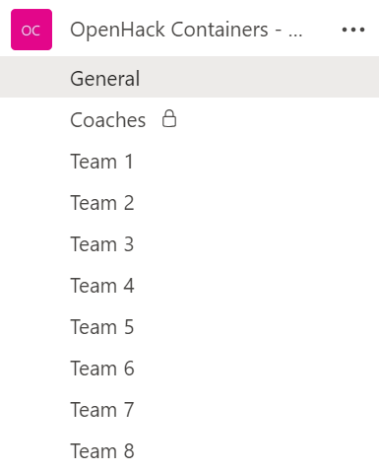
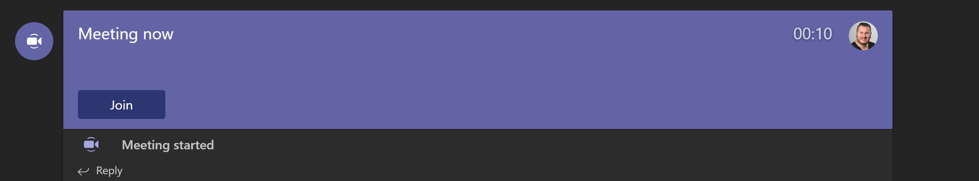
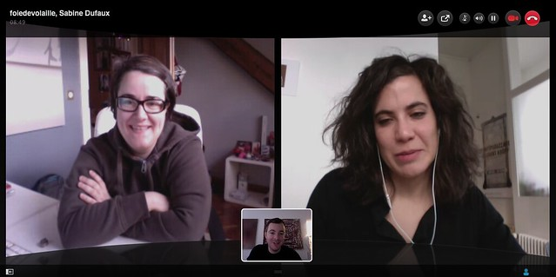
Collaborate
Step 1 (Move to Team channel)
Step 2 (Coach starts a meeting)
Step 3 (Join the meeting)
Your channel is your Team #
Step 4 (Turn on mic and video)
insert snip of actual Team channel
This Photo by Unknown Author is licensed under CC BY

Slide 18
Logging into the classroom
OpenHack Portal: aka.ms/ohportal
Login: 1@skillmeup.com
PW: Password123!
Insert skillmeup credentials
Insert Team # here i.e. 1

Slide 19
Thank you for joining

Slide 20

OpenHack Day 2
Microsoft Azure Well-Architected Framework
[Month] [Start Date – End Date]
#MSOpenHack

Slide 21
Agenda
Sample agenda - update with Day 2 & 3
<date> | <date>
9:00 – 9:30 AM | Morning Announcements 9:30 AM – 12:00 PM | Team Hacking 12:00 – 1:00 PM | Break 1:00 – 4:00 PM | Team Hacking 4:00 PM | End of Day 2 | 9:00 – 9:30 AM | Morning Announcements 9:30 AM – 12:00 PM | Team Hacking 12:00 – 1:00 PM | Break 1:00 – 3:30 PM | Team Hacking 3:30 – 4:00 PM | Closing Remarks 4:00 PM | End of OpenHack

Slide 22
Optimizing the Virtual Experience
Each team will have their own channel for collaboration
Collaborate in Microsoft Teams and monitor the General channel for updates
Keep your mic and video on to promote engagement (pet & kid noises welcome!)
Add all feedback to the Opsgility portal
Take breaks as needed but suggest doing so as a team so no one is left behind
Teams can hack earlier / later than the event times, just note coaches are only available during posted times: <start time> – <end time> <time zone>
Include last bullet at Project Lead’s discretion
Notes:
Working agreement = breaks, standups, retros, alternate sharing screen on challenges

Slide 23
OpenHack Code of Conduct
Microsoft’s mission is to empower every person and every organization on the planet to achieve more. This includes all Microsoft events and gatherings, including on digital platforms, where we seek to create a respectful, friendly, fun and inclusive experience for all participants.
We expect all digital event participants to uphold the principles of this Code of Conduct, which covers the main digital event and all related activities. We do not tolerate disruptive or disrespectful behavior, messages, images, or interactions by any party participant, in any form, at any aspect of the program including business and social activities, regardless of location.
Microsoft will not tolerate harassment or discrimination based on age, ancestry, color, gender identity or expression, national origin, physical or mental disability, religion, sexual orientation, or any other characteristic protected by applicable local laws, regulations, and ordinances.
Photography, video or recording of session content or presentations in any format shared in social channels is prohibited. We encourage everyone to assist in creating a welcoming and safe environment. Please report any concerns, harassing behavior, suspicious, or disruptive activity to Business Conduct Hotline (1-877-320-MSFT or buscond@microsoft.com). Microsoft reserves the right to refuse admittance to or remove any person from Microsoft OpenHack at any time at its sole discretion.

Slide 24
OpenHack Day 3
Microsoft Azure Well-Architected Framework
[Month] [Start Date – End Date]
#MSOpenHack

Slide 25
Agenda
Sample agenda - update for last day
<date>
9:00 – 9:30 AM | Morning Announcements 9:30 AM – 12:00 PM | Team Hacking 12:00 – 1:00 PM | Break 1:00 – 3:30 PM | Team Hacking 3:30 – 4:00 PM | Closing Remarks 4:00 PM | End of OpenHack

Slide 26
Optimizing the Virtual Experience
Each team will have their own channel for collaboration
Collaborate in Microsoft Teams and monitor the General channel for updates
Keep your mic and video on to promote engagement (pet & kid noises welcome!)
Add all feedback to the Opsgility portal
Take breaks as needed but suggest doing so as a team so no one is left behind
Teams can hack earlier / later than the event times, just note coaches are only available during posted times: <start time> – <end time> <time zone>
Include last bullet at Project Lead’s discretion
Notes:
Working agreement = breaks, standups, retros, alternate sharing screen on challenges

Slide 27
OpenHack Code of Conduct
Microsoft’s mission is to empower every person and every organization on the planet to achieve more. This includes all Microsoft events and gatherings, including on digital platforms, where we seek to create a respectful, friendly, fun and inclusive experience for all participants.
We expect all digital event participants to uphold the principles of this Code of Conduct, which covers the main digital event and all related activities. We do not tolerate disruptive or disrespectful behavior, messages, images, or interactions by any party participant, in any form, at any aspect of the program including business and social activities, regardless of location.
Microsoft will not tolerate harassment or discrimination based on age, ancestry, color, gender identity or expression, national origin, physical or mental disability, religion, sexual orientation, or any other characteristic protected by applicable local laws, regulations, and ordinances.
Photography, video or recording of session content or presentations in any format shared in social channels is prohibited. We encourage everyone to assist in creating a welcoming and safe environment. Please report any concerns, harassing behavior, suspicious, or disruptive activity to Business Conduct Hotline (1-877-320-MSFT or buscond@microsoft.com). Microsoft reserves the right to refuse admittance to or remove any person from Microsoft OpenHack at any time at its sole discretion.

Slide 28
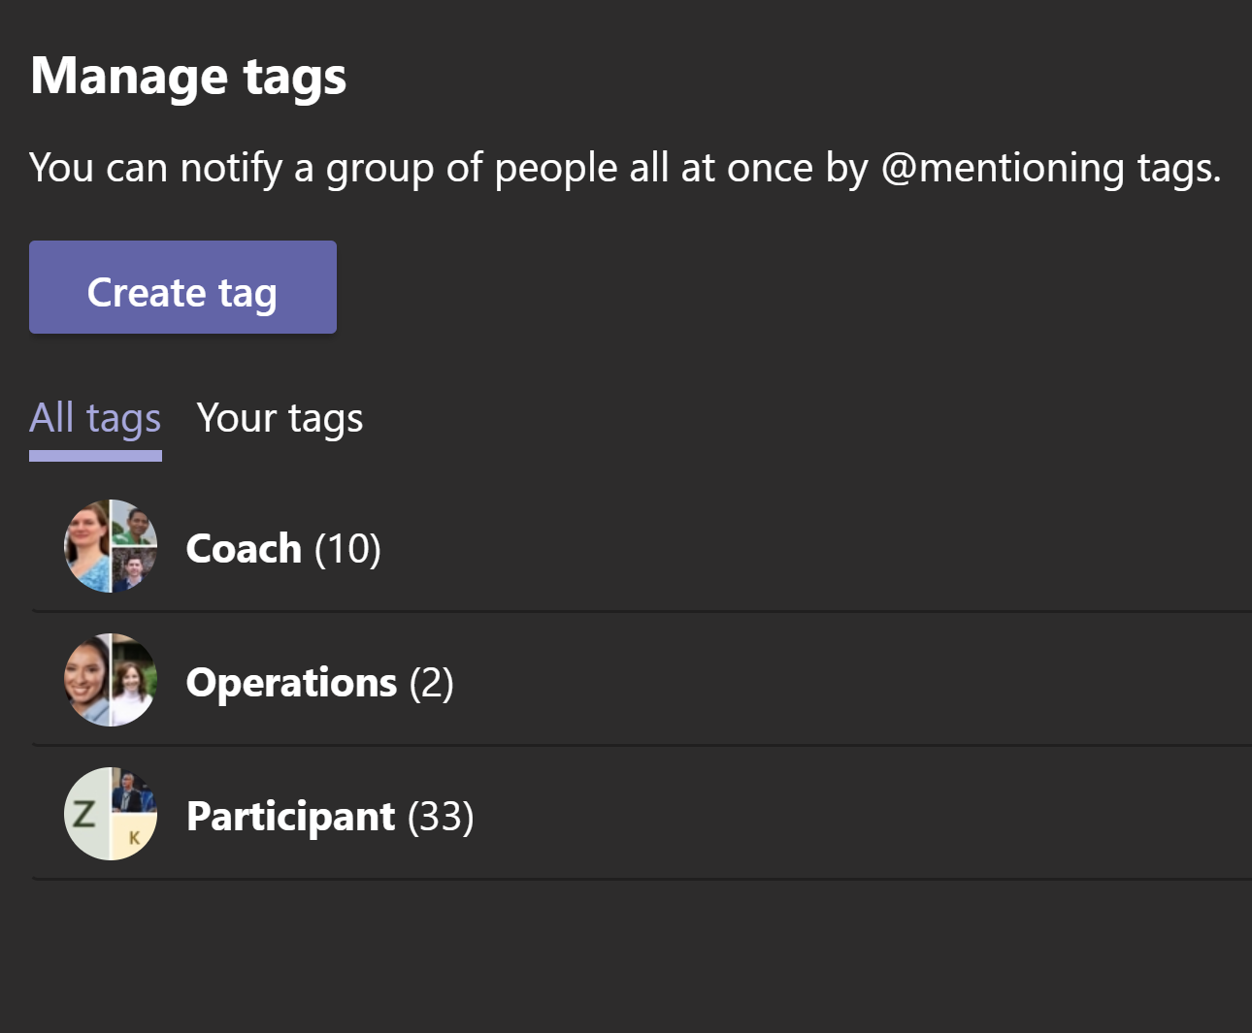
Tagging in Coaches
Delete first bullet if not covering multiple time zones
Coaches have been assigned by area to provide coverage across time zones
Coaches will keep a close pulse on active channels and regularly monitor
If you have an immediate request (i.e., need challenge approval or other tech question), you can:
Tag / Teams message your area coach
and / or
Tag / Teams message the “@coach” handle which will trigger a notice to all available coaches

